Slide 1
Graph of Content
The Towels
Notes:
dfhdfgh
<Foliennummer>

Slide 2
Basic Ideas
Lecturer sorts its lectures in a Graph
Add different media to nodes
PDF
VIDEOS
HTML-Files
Binaries
Students add personal comments to node
=> Enhanced overview of learning content
<Foliennummer>
WebTechnologies

Slide 3


Technologies
<Foliennummer>
WebTechnologies

Slide 4
What we have now
Running deployment environment
Maven
Bower
Grunt
→ Glassfish
Project analysis and design
Data Model implemented
<Foliennummer>
WebTechnologies

Slide 5
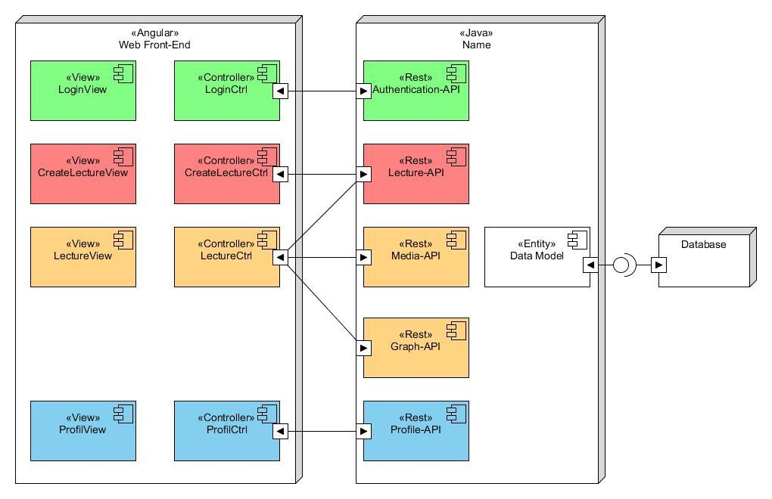
Excerpt of Components
<Foliennummer>
WebTechnologies

Slide 6
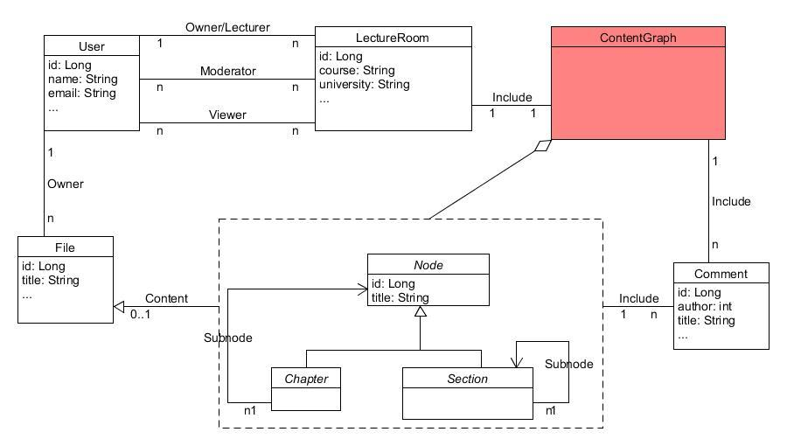
Database
<Foliennummer>
WebTechnologies

Slide 7
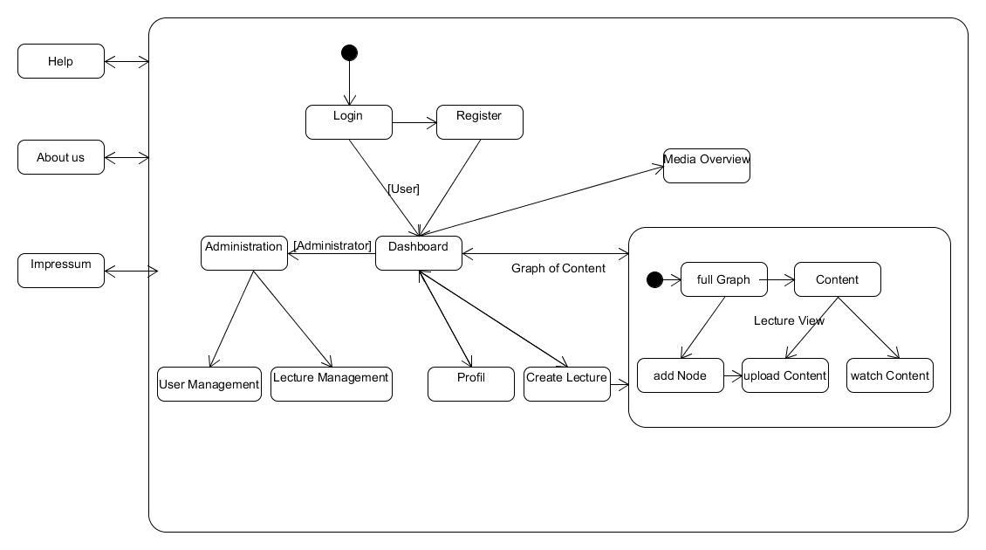
Navigation
<Foliennummer>
WebTechnologies

Slide 8
Development strategy
Scrum
JiRA
GitHub
VirtualMachine
Communication
Not enough analysis
Started to late
positive
negative
<Foliennummer>
WebTechnologies

Slide 9
Future steps
REST APIs
Design Masterpage
Create Views
Editor for Graph Of Content
Students add personal comments to node
(Comment feature for pages)
<Foliennummer>
WebTechnologies

Slide 10
Thanks for listening
<Foliennummer>
Name of the lecture

